Slide 1


DATA620 Project 2 Graphing Movies and Actors
Team 6
Alice Friedman, Stephen Jones, Jeffrey Littlejohn, Jun Pan

Slide 2
Internet Movie Database (IMDB)
Source: www.kaggle.com
Internet Movie Database: 1000 most popular movies made from 2006-2016
Directly get data from IMDB official website was not practical for us. (format issue, too large of dataset, no necessary information which we need)

Slide 3
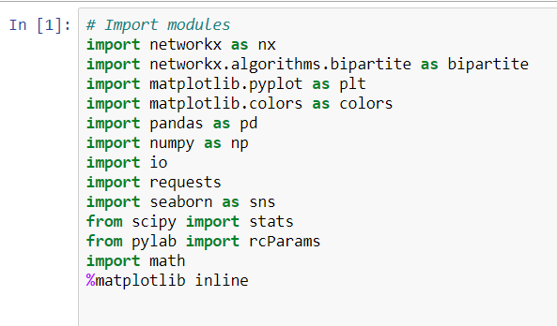
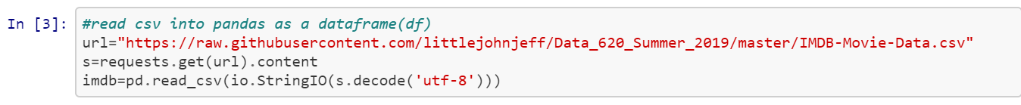
Import Modules and Load Data

Slide 4
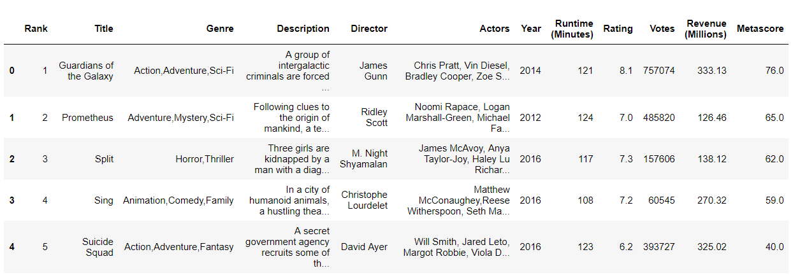
Overview of Data

Slide 5
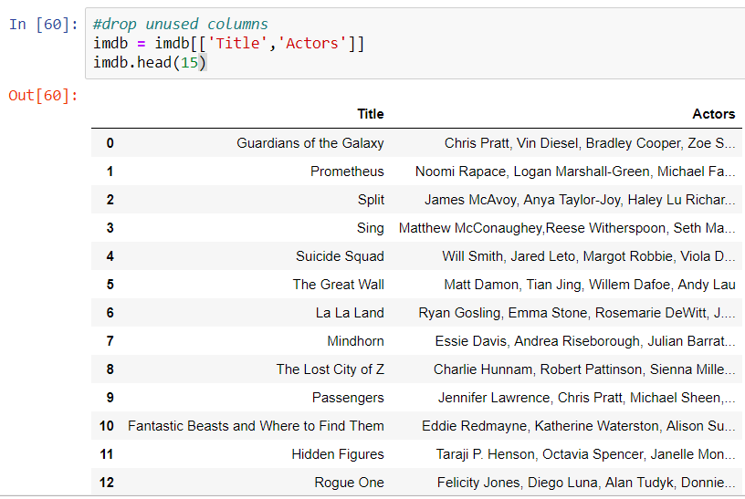
Our primary goal: Identify a large 2-node network dataset.

Slide 6
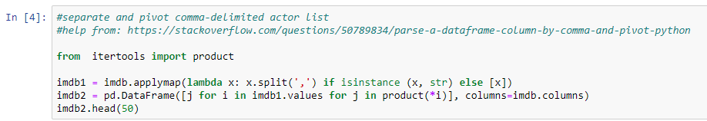
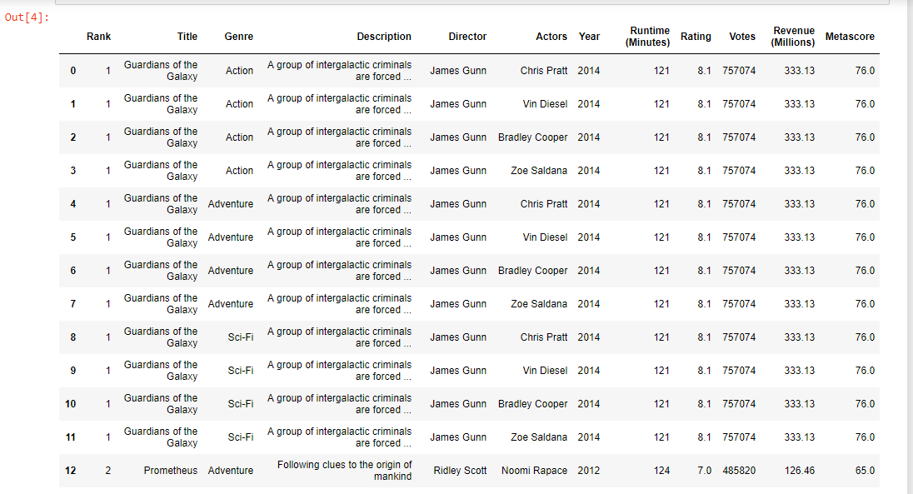
Separate actor list
23, 032 rows

Slide 7
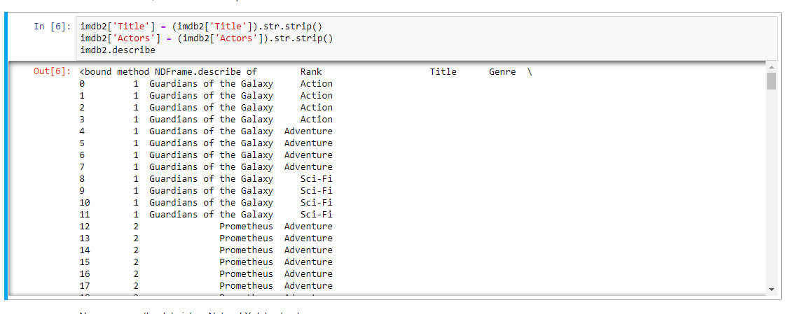
Remove white space

Slide 8
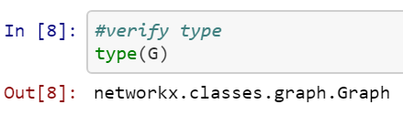
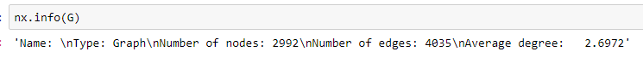
Move the data into a NetworkX data structure
The number of edges matches the number of rows from our dataframe, which matches our expectations.

Slide 9
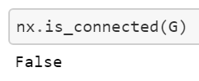
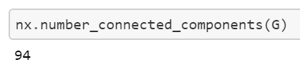
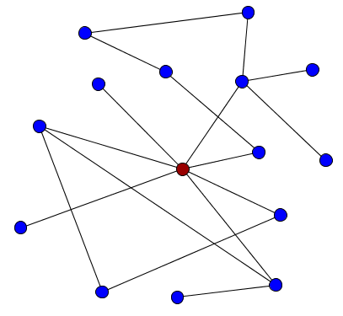
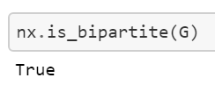
Analysis before visualization

Slide 10

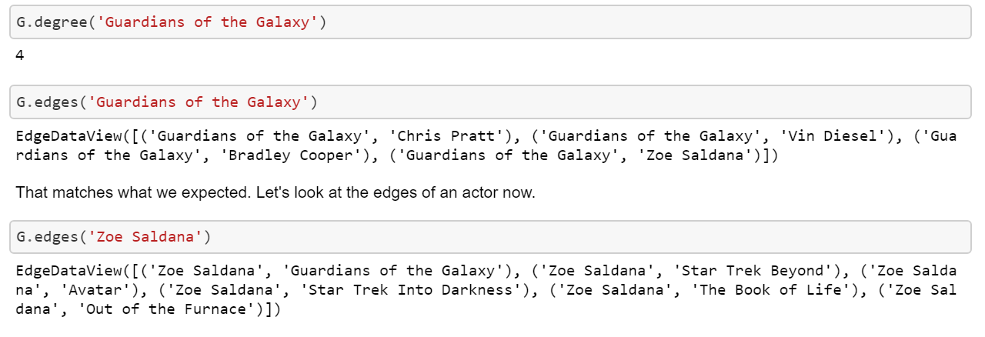
Example: Guardian of Galaxy

Slide 11
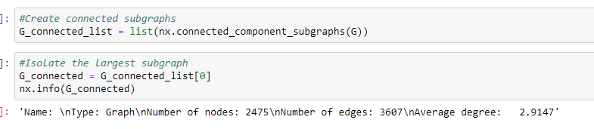
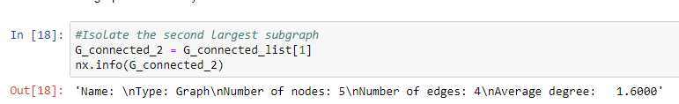
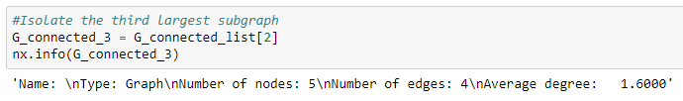
List of Subgraphs

Slide 12
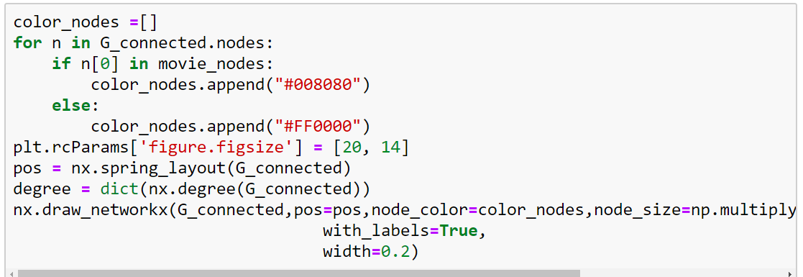
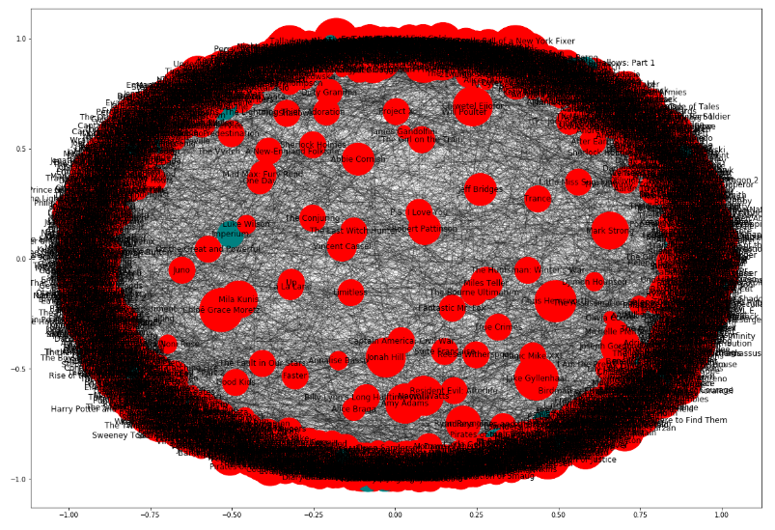
Visualize Largest Subgraphs

Slide 13
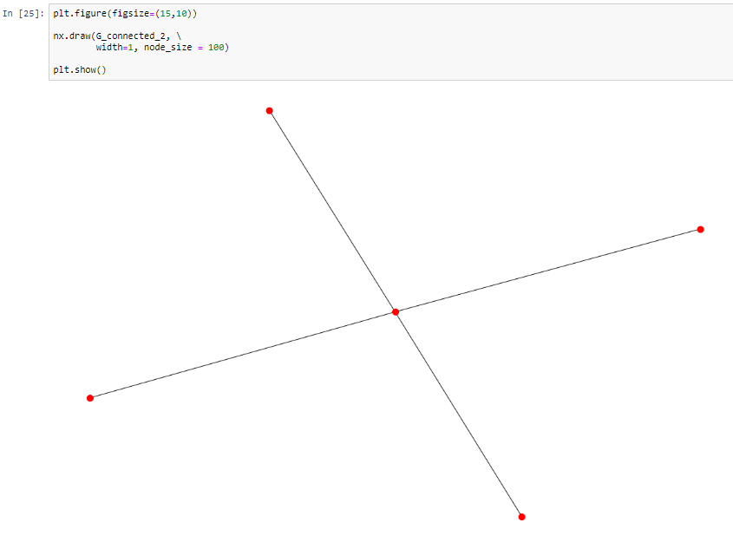
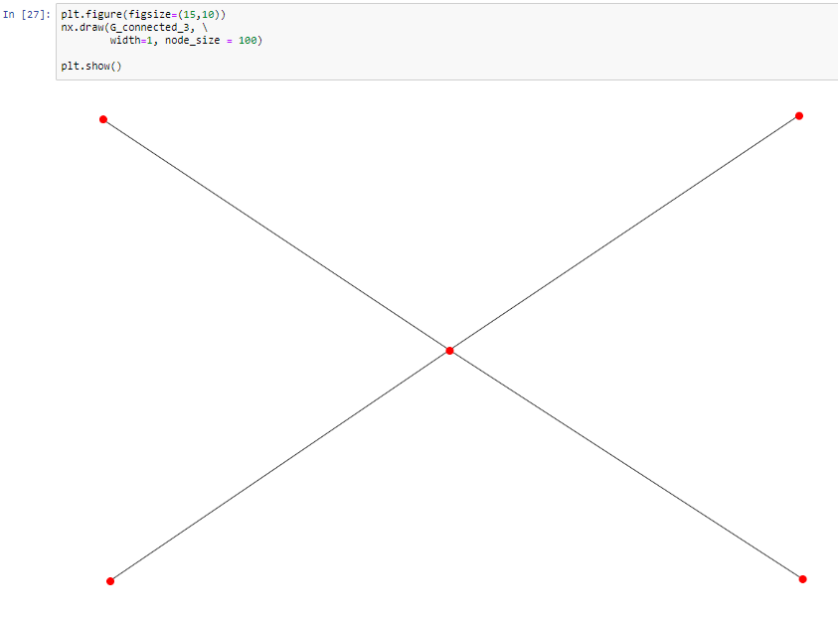
2nd and 3rd Largest Subgraph

Slide 14
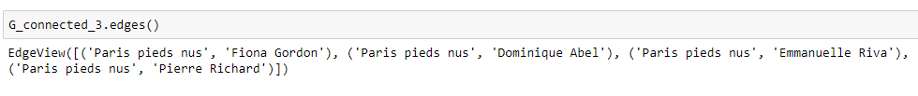
Movie/Actor Involvement

Slide 15
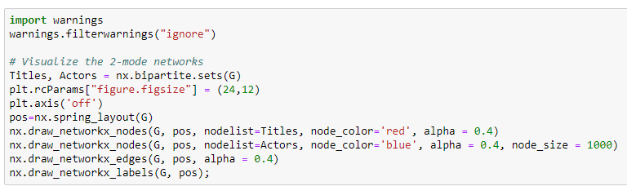
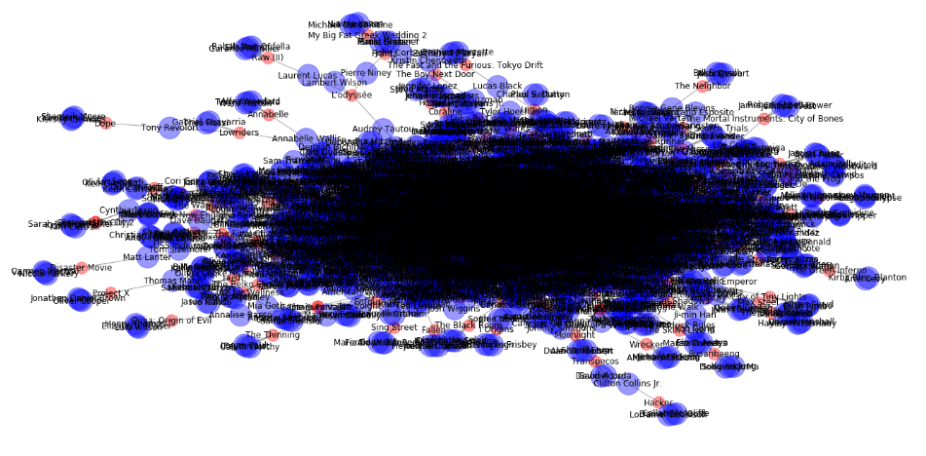
Visualize 2 mode networks

Slide 16
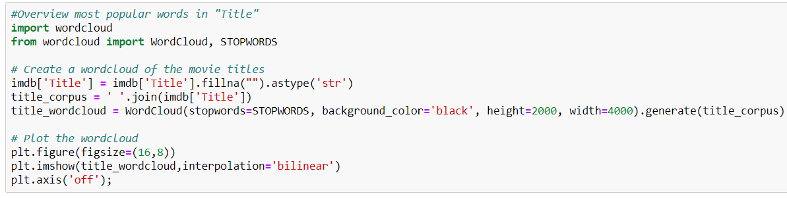
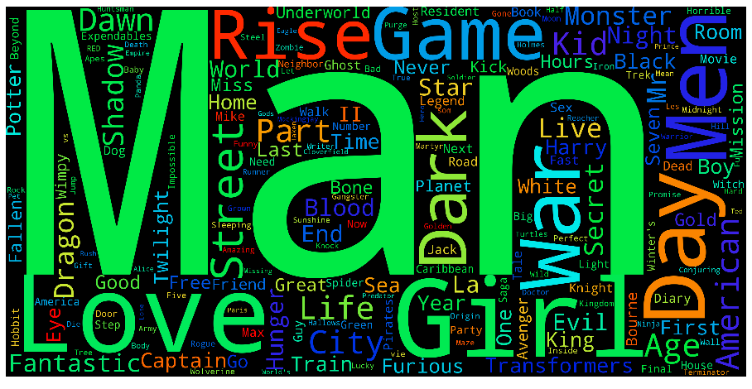
Popular Words in Title: Man, Love, Girl, Rise, Game, Day …

Slide 17
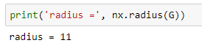
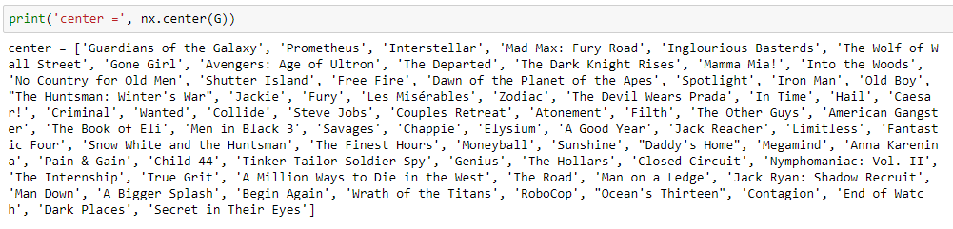
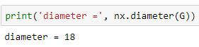
Distance calculations
Radius: is the shortest distance between a node and all other nodes.
movies cover a few genres
Diameter: shortest path between the largest subgraph and the furthest away node in the graph.

Slide 18
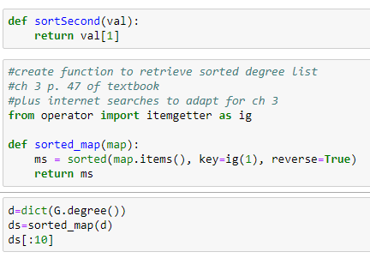
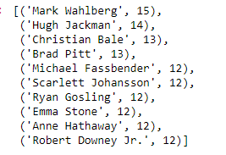
Practice based on chapter 3 of textbook
Degrees here simply captures the number of times a node appears in the dataset. So Wahlberg's in the most of the top 1000 movies from 2006-2016. Between bad action movies and some suprise hit comedies, this makes sense. Movies would show up here only if they had larger casts included in the dataset.

Slide 19
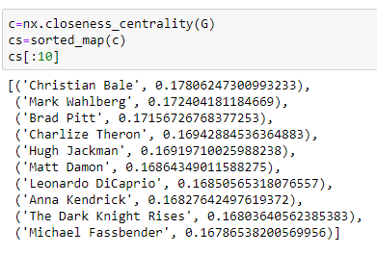
Meaning: a node's ability to reach all other nodes in the network with fewest edges.

Slide 20
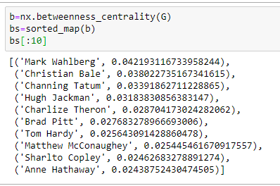
Betweeness centrality, according to our textbook, is based on the idea that power resides in bottlenecks between networks. So a cross-genre actor like Hugh Jackman who appears in action films, musicals, and romantic comedies might be an important connector to different groups of actors.

Slide 21
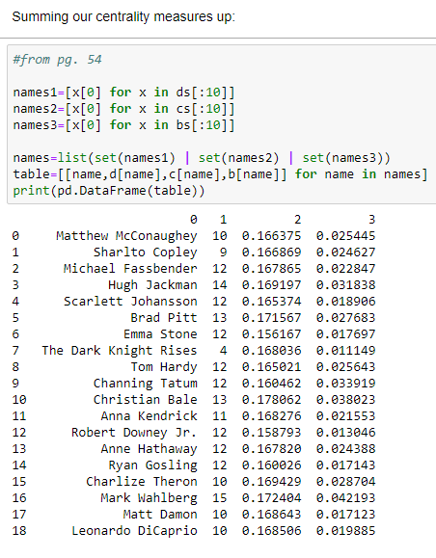

Slide 22
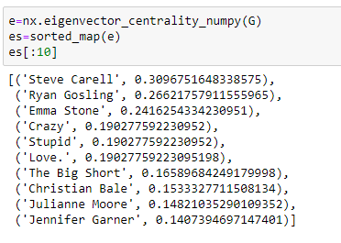

Slide 23
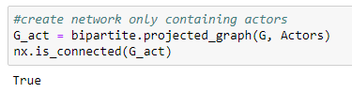
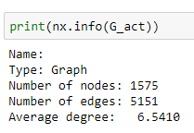
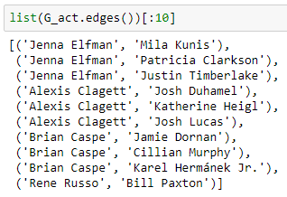
Create network only contain actor

Slide 24
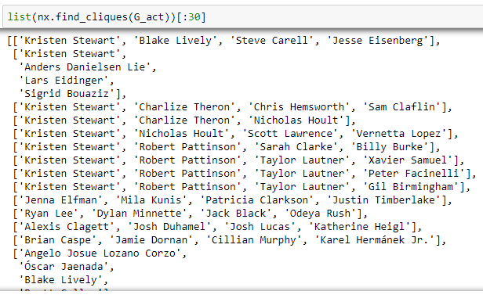
Cliques of Actors

Slide 25
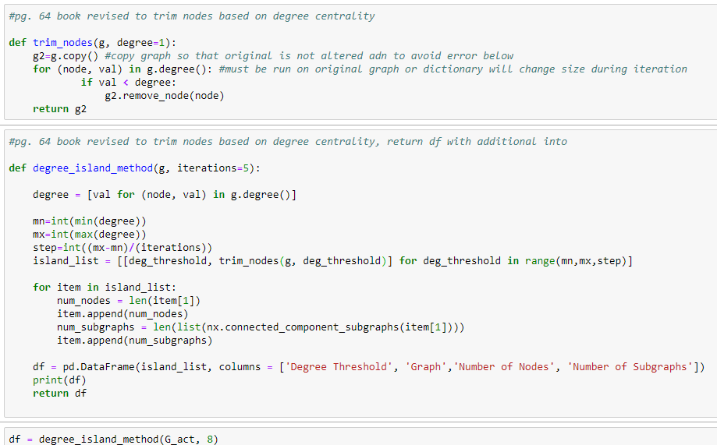
Island Method For Subgraphs Method 1: Raise Degrees:

Slide 26
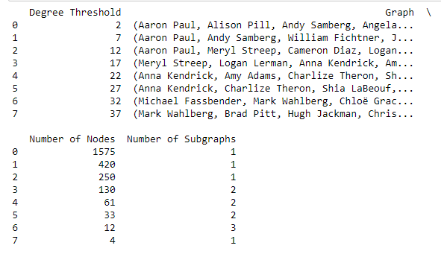
Result

Slide 27
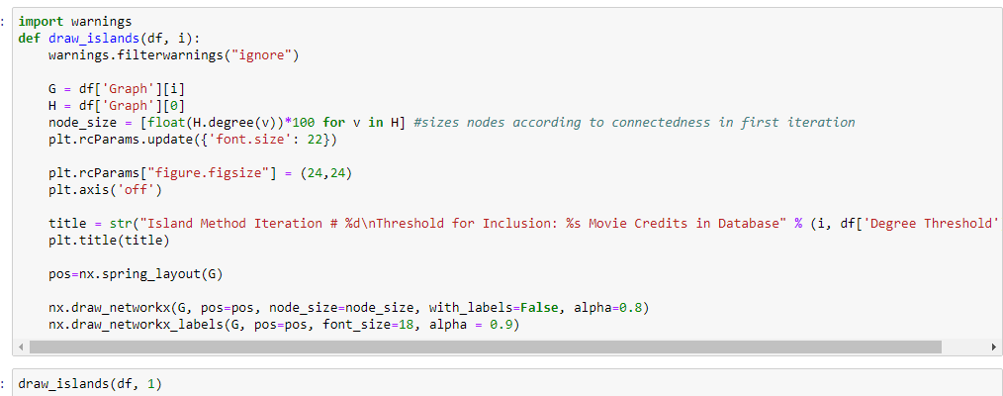
Visualize the Islands

Slide 28
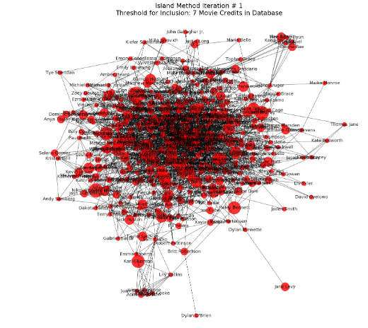
Threshold = 7

Slide 29
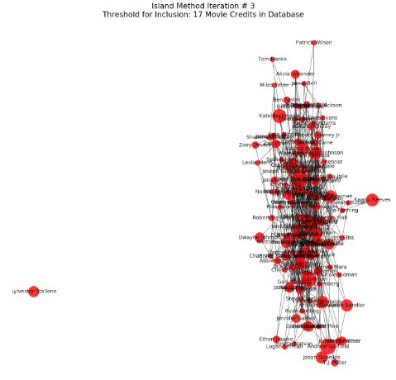
Threshold = 17

Slide 30
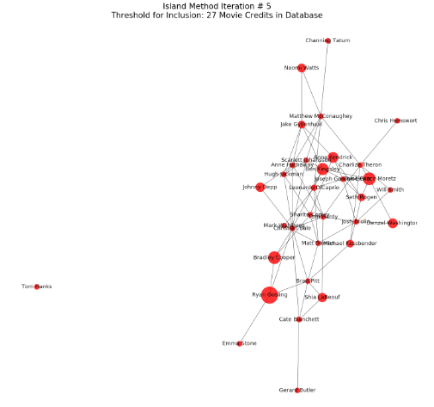
Threshold = 27

Slide 31
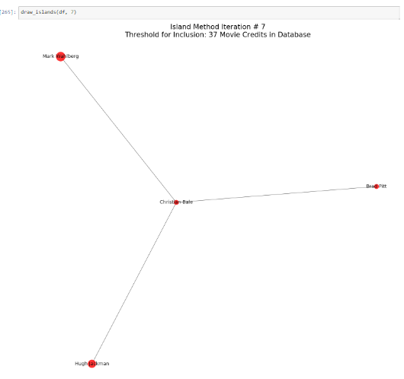
Threshold = 37

Slide 32
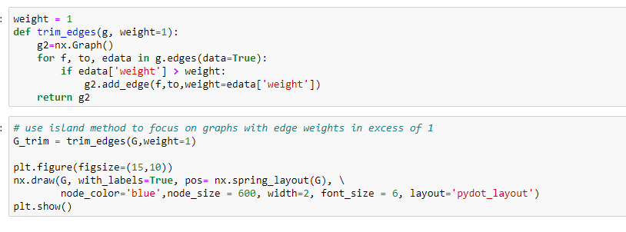
Island Method For Subgraphs Method 1: Raise Weights: wt=1

Slide 33
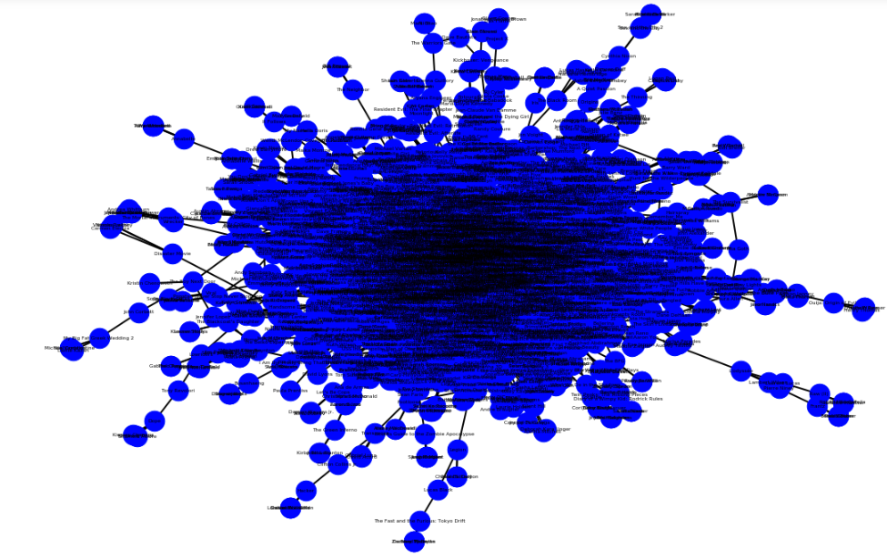
Weight =1

Slide 34
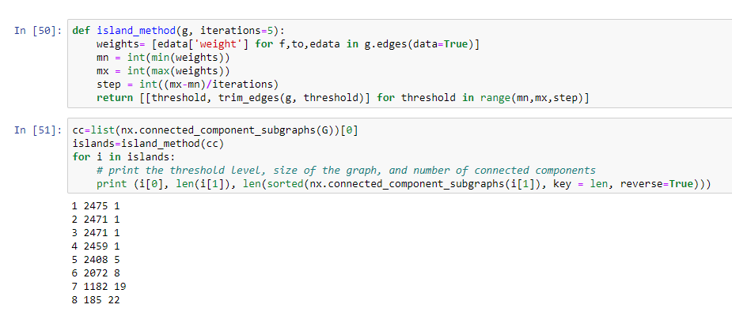
Raise difference weight

Slide 35
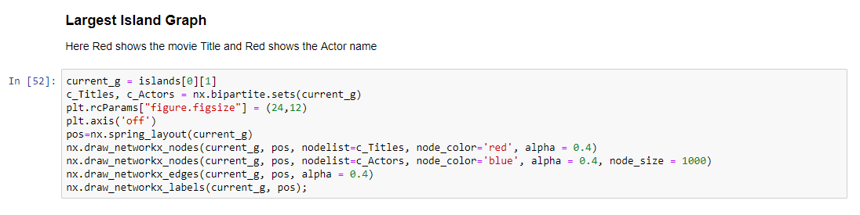


Slide 36


Slide 37

Smallest Island

